Slide 1
Union 101

Slide 2
What do you think a UNION is?
Anyone… Anyone... Buhler...

Slide 3
What is a union?
A union refers to an organization of employees recognized by the labour board, who come together as a single entity to address hours, pay, and working conditions with their employer.
It is a democratic institution with leadership at the provincial, regional and local levels who are elected by members (like the legislature or parliament). It has a constitution that is drafted and ratified by members, much like the constitution of Canada. Nothing at the local, regional levels can supersede the constitution.

Slide 4
History of unionization in Canada
As the industrial revolution expanded and our country, the world of work changed.
Many people were attracted to factory towns and away from their agrarian roots where life and work were often very similar and on a much smaller scale.
With the advent of factories and the expansion of Canada, there was a greater divide between the employer and employee.
Issues arose around working conditions, safety, pay, benefits, equity as well as a myriad of other issues.
Workers began to organize to protect themselves and their futures.

Slide 5
What are the benefits of being in a union?
Your thoughts??

Slide 6
Benefits of unionization
MEMBERSHIP HAS ITS PRIVILEGES!
Job security
Improved wages
Health care, pension plans and other benefits
Health and safety
Scheduling of hours
A stronger voice through collective bargaining
A right to vote on your contract

Slide 7
Thanks to unions…
Free public education at the elementary and secondary levels
Paid vacations
Minimum wages
Workers’ compensation
Pay equity
The right to organize
A limit on the hours of work
Medicare
CPP
Overtime pay
Severance pay
Job security
Cost of living raises
Ban on Child labour
Imagine what life would be like as an employee without them…. Say goodbye to the weekend.

Slide 8
Our union: What is OSSTF?
The Ontario Secondary School Teachers’ Federation
Founded in 1925
60 000 members
230 job classes
149 bargaining units (PSAT D30 is one)
35 Districts
1 UNION
Source: OSSTF/FEESO Annual Report 2014-2015.

Slide 9
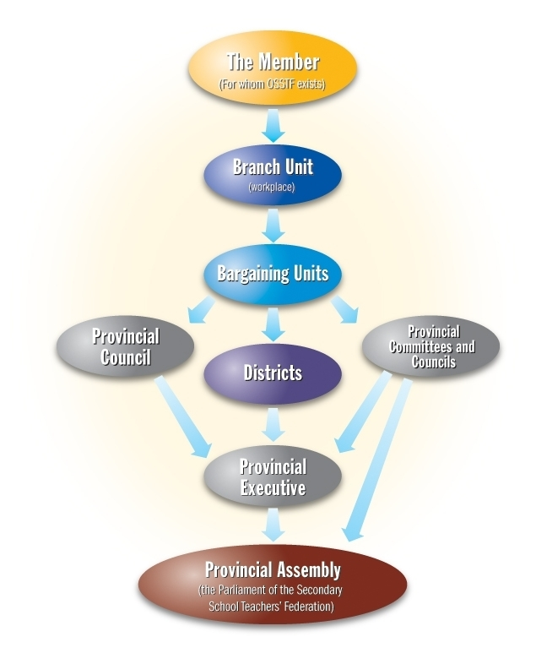
Structure of OSSTF

Slide 10
What is PSAT?
The Provincial School Authority Teachers
It has 207 full-time equivalent (FTE) teachers
We are a bargaining unit within OSSTF - known as District 30 PSAT.
Notes:
Talk about the history of PSAT as an association

Slide 11
Structure of PSAT
Currently we have three electorate votes at AMPA (Annual Meeting of the Provincial Assembly) which is OSSTF’s parliament.
We have one Executive Officer (District Officer) with full time release, and a President with no release. We have four executive members (including a treasurer, and vice president)
Committees (constitution, election, finance, political action, professional development central committee, and negotiations)
Notes:
Time commitment (do not have to meet in one place, done over email, conference calls…)

Slide 12
What is the relationship between OSSTF and PSAT?
PSAT is an affiliate of OSSTF. We are affiliate members who can access OSSTF legal support, educational services, and other resources.
PSAT pays dues to OSSTF for this privilege.
Any PSAT member can apply to OSSTF committees, job posting, etc. We have the same opportunities as any other OSSTF member.

Slide 13
Skill testing question(s)
Who is the PSAT D30 president?
How about the treasurer?
Who is on the executive?
Who is your branch representative?

Slide 14
PSAT executive is…
Voting members:
Elected individuals who volunteer their time to do the union’s work (2 year terms):
President (David Sykes)
Vice President (Odette Lopes)
Treasurer (Craig Hughes)
Secretary (Ginette Legault)
Executive Officers (Scott Garant)
Non-voting member:
Appointed individual who is paid for their time to do the union’s work (1 year term):
District Officer (Al Pagnan)

Slide 15
What does the Executive do?
Act as the legislative branch of PSAT.
Hold meetings to discuss union business (discuss motions and direction of PSAT that affect the welfare of members and maintenance of our collective agreement)
Share information between Provincial OSSTF and members (via PSAT president and Provincial Council, the executive liaison, secretariat assigned to PSAT)
Negotiate and maintain collective agreement
Oversee the executive officer’s work
Notes:
Executive discusses member concerns and makes decisions about how to rectify them not always a grievance (JRC)
Members do not always have to grieve and the union can take it forward. Need to be aware of what is happening at sites. The first step is not always a grievance but need to bring issues forward in a variety of ways.
Grievances are the last line of defense to be used when it cannot be solved. Informal meetings (either President or District Officer), JRC (resolve before they have to be grieved; preferred) The majority of issues are resolved this way.
Policy grievances as opposed to individual grievances

Slide 16
What does the District Officer do?
Represents members facing discipline
Resolves issues between the union and management as raised by members or advanced by the executive.
Assists members on a day-to-day basis with the employer to solve problems acting as the grievance officer
Acts as the chief negotiator for the bargaining unit
(Duties of District Officer are outlined in section 2 of the PSAT constitution).

Slide 17
What does the Branch Representative do?
Reports to the District Office, concerns about how management applies the collective agreement
Is head of the ISSC (In School Staffing Committee)
Represents members in meetings with management
Answers questions about the Collective Agreement, and refers issues to the Executive Coordinator (District Officer)
Can act as the first step to resolve any issues in the workplace’
Steps to resolve an issue:
Member branch rep district officer provincial office

Slide 18
What do you need to do as a member?
Step up! Get involved!
Discuss any issues or concerns with your union rep (branch representative)
Volunteer for a committee
Vote!
Know your rights. Read and know your collective agreement.
Report violations of the collective agreement; protect your workplace.
TOGETHER WE STAND…DIVIDED WE FALL!

